Slide 1
ROCK PAPER SCISSORS

Slide 2
INDEX
Introduction​
Primary goals
Timeline
Learning outcome

Slide 3
INTRODUCTION
A simultaneous, zero-sum game, it has three possible outcomes: a draw, a win or a loss. A player who decides to play rock will beat another player who has chosen scissors ("rock crushes scissors" or "breaks scissors" or sometimes "blunts scissors") but will lose to one who has played paper ("paper covers rock"); a play of paper will lose to a play of scissors ("scissors cuts paper"). If both players choose the same shape, the game is tied and is usually immediately replayed to break the tie.
Rock paper scissors is often used as a fair choosing method between two people, like coin flipping, drawing straws, or throwing dice in order to settle a dispute or make an unbiased group decision

Slide 4
PRIMARY GOAL
GAME USING JAVA PROGRAMMING
Game programming, a subset of game development, is the software development of video games. Game programming requires substantial skill in software engineering and computer programming in a given language, as well as specialization in one or more of the following areas: simulation, computer graphics, artificial intelligence, physics, audio programming, and input.
The most popular languages are usually procedural or object-oriented and implemented via compilers; for example, C, C++,and Java.

Slide 5
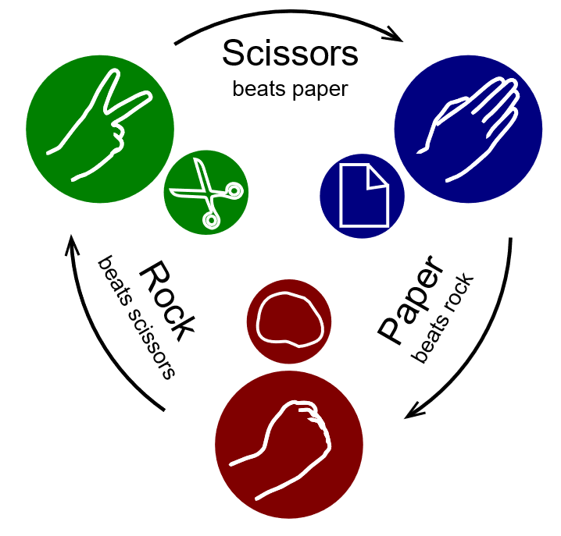



WIN

Slide 6
MEET OUR TEAM
KAVISH MEHTA
DIVYANSHU
MAYANK SARAF
210C2030188
210C2030182
210C2030176

Slide 7
TIMELINE
SEP 2022
OCT 2022
NOV 2022
DEC 2022
Discussing and planning the project
Coding part for 2 player interface
Coding part completed
Enabling third player play
Debugging and finalization

Slide 8
LEARNING OUTCOME
MAKING GAMES USING OOPS
STRENGTHENING JAVA BASICS
LEARNING BASIC GAME DEVELOPMENT

Slide 9
Github link
https://github.com/ItzDivyanshu/Java-Game-Project

Slide 10
THANK YOU

